Slide 1
Chapter 19: Diode Applications (Part 4)
Diode Limiting Circuits
Copyright © 2010 Christopher Teoh, Tan HJ & Wong WY Singapore Polytechnic. All rights reserved.

Slide 2
Objectives
After completing Part 4 of this chapter, you will be able to:
Understand the operation of the following diode limiting circuits :
Positive Limiter
Negative Limiter

Slide 3
19-6 Diode Limiting Circuits
Diode limiting circuits (also called limiters or clippers) are used to clip off portions of signal voltages above or below certain levels.
3 main categories
Positive Limiters
Negative Limiters

Slide 4
Diode Limiters
The following limiter (or clipper) limits or clips the positive part of the input voltage.
R₁
V_{p}
V_{in}
+
+0.7V
0
R_{L}
V_{out}
0
_
I
-V_{p}
The diode is forward biased during the positive alternation (0.7V) and reverse-biased during the negative alternation.
Question: Is the negative peak of Vout equal to –V_{p}?
Answer: No!
Try to figure out why. Answer in next slide.

Slide 5
The following limiter (or clipper) limits or clips the negative part of the input voltage.
R₁
V_{p}
V_{in}
_
0
R_{L}
V_{out}
0
I
-0.7V
-V_{p}
+
The diode is forward biased during the negative alternation (below -0.7V) and reverse-biased during the positive alternation.
During positive cycle:
Answer to V_{p} question!
If R₁ is small compared to R_{L}, then V_{out}=V_{in}

Slide 6
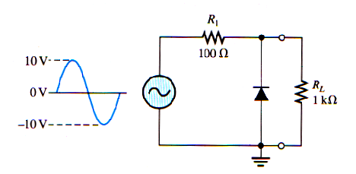
Example 19-5

Slide 7
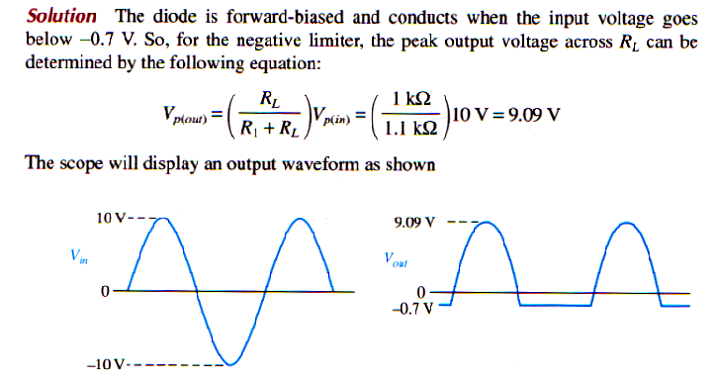

Slide 8
Summary
Diode limiters clip off voltage above or below required levels. Limiters are also called clippers.
The three major categories of limiters are :
Positive Limiter
Negative Limiter

Slide 9
End of Chapter 19

